Slide 1
5
INVERSE FUNCTIONS

Slide 2
5.6
Inverse Trigonometric Functions

Slide 3
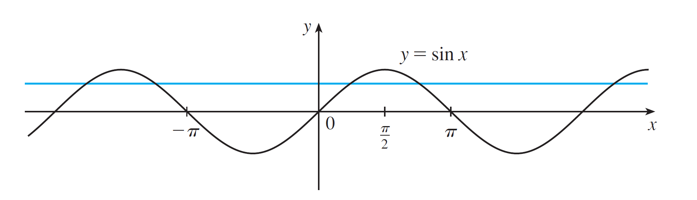
Inverse Trigonometric Functions
We know that the only functions that have inverse functions are one-to-one functions. Trigonometric functions, however, are not one-to-one and so they don’t have inverse functions. But we can make them one-to-one by restricting their domains.
You can see from Figure 1 that the sine function y = sin x is not one-to-one (use the Horizontal Line Test).
Figure 1

Slide 4
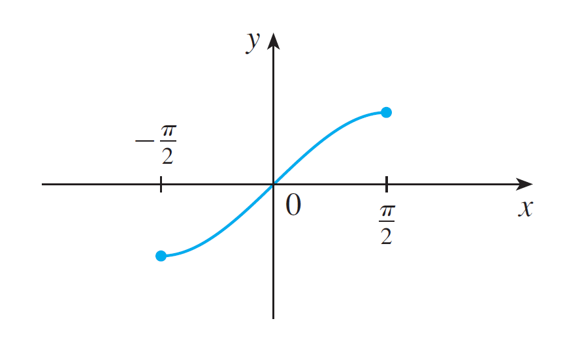

Inverse Trigonometric Functions
But the function (see Figure 2), is one-to-one.
Figure 2

Slide 5
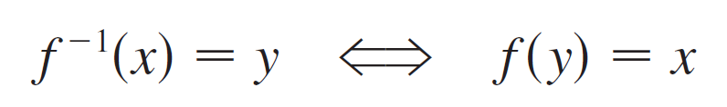
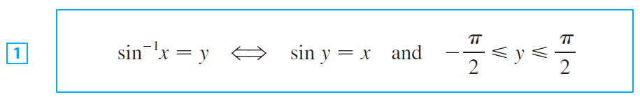

Inverse Trigonometric Functions
The inverse function of this restricted sine function f exists and is denoted by sin^{–1} or arcsin. It is called the inverse sine function or the arcsine function.
Since the definition of an inverse function says that
we have
Thus if is the number between –π /2 and π/2 whose sine is x.

Slide 6
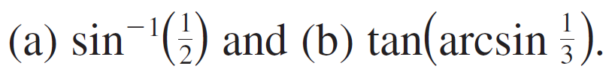
Example 1
Evaluate (a) and (b)

Slide 7
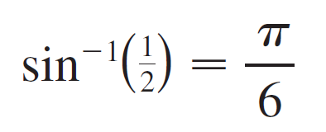
Example 1 – Solution
SOLUTION:
(a) We have
because sin(π /6) = ½ and π /6 lies between –π /2 and π /2.

Slide 8
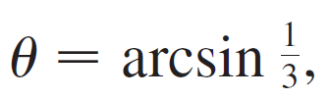


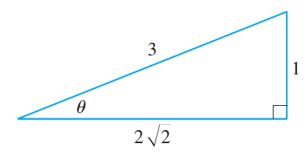
Example 1 – Solution
cont’d
(b) Let so
Then we can draw a right triangle with angle θ as in Figure 3 and deduce from the Pythagorean Theorem that the third side has length
Figure 3

Slide 9
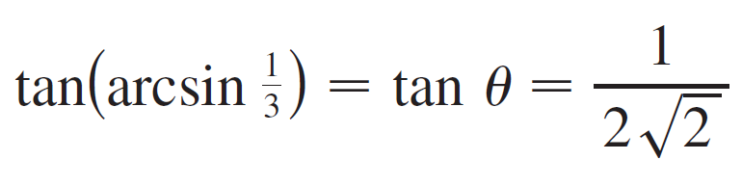
Example 1 – Solution
cont’d
This enables us to read from the triangle that

Slide 10
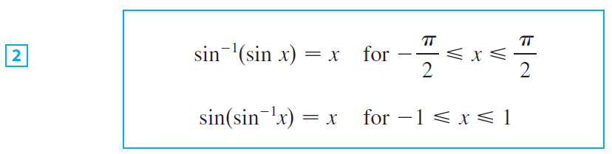
Inverse Trigonometric Functions
The cancellation equations for inverse functions become, in this case,

Slide 11
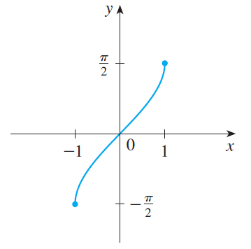

Inverse Trigonometric Functions
The inverse sine function, sin^{–1}, has domain [–1, 1] and range [–π /2, π /2], and its graph, shown in Figure 4, is obtained from that of the restricted sine function (Figure 2) by reflection about the line y = x.
Figure 4
Figure 2

Slide 12
Inverse Trigonometric Functions
We know that the sine function f is continuous, so the inverse sine function is also continuous.
We also know that the sine function is differentiable, so the inverse sine function is also differentiable.
We could calculate the derivative of sin⁻¹ by the formula in Theorem 5.1.7, but since we know that sin⁻¹ is differentiable, we can just as easily calculate it by implicit differentiation as follows.

Slide 13


Inverse Trigonometric Functions
Let y = sin⁻¹x . Then sin y = x and - π /2 ≤ y ≤ π /2. Differentiating sin y = x implicitly with respect to x, we obtain
and

Slide 14


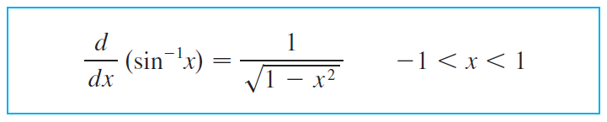

Inverse Trigonometric Functions
Now cos y ≥ 0 since -π / 2 ≤ y ≤ π / 2, so
Therefore

Slide 15
Example 2
If f(x) = sin^{–1}(x² – 1), find (a) the domain of f. (b) f ’(x). (c) the domain of f ’.

Slide 16
Example 2(a) SOLUTION
Since the domain of the inverse sine function is [– 1, 1], the domain of f is:

Slide 17
Example 2(b) SOLUTION
Combining Formula 3 with the Chain Rule, we have:

Slide 18
Example 2(c) SOLUTION
The domain of f ’ is:

Slide 19

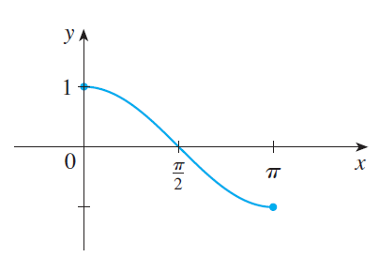

Inverse Trigonometric Functions
The inverse cosine function is handled similarly. The restricted cosine function is one-to-one (see Figure 6) and so it has an inverse function denoted by cos^{–1} or arccos.
Figure 6

Slide 20

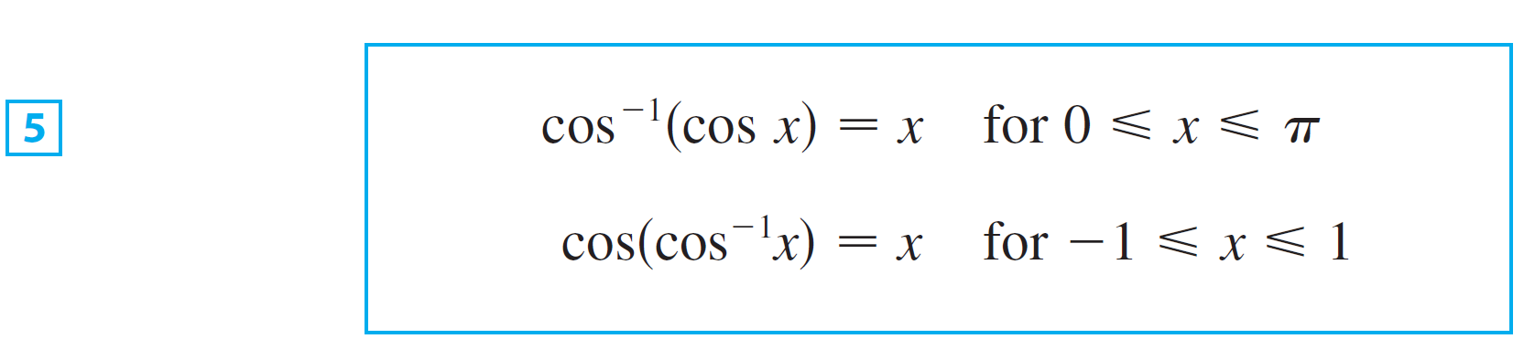
Inverse Trigonometric Functions
The cancellation equations are

Slide 21
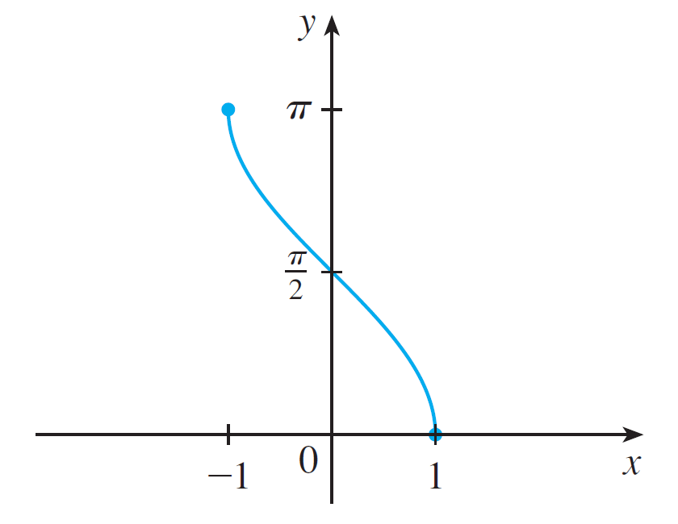

Inverse Trigonometric Functions
The inverse cosine function, cos^{–1}, has domain [–1, 1] and range [0, π ] and is a continuous function whose graph is shown in Figure 7.
Figure 7

Slide 22

Inverse Trigonometric Functions
Its derivative is given by

Slide 23
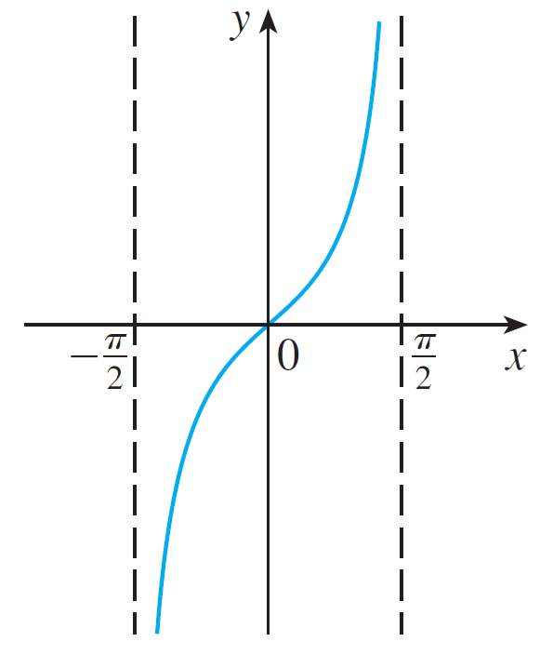
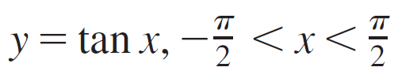
Inverse Trigonometric Functions
The tangent function can be made one-to-one by restricting it to the interval (–π /2, π /2). Thus the inverse tangent function is defined as the inverse of the function f (x) = tan x, –π /2 < x < π /2. (See Figure 8.)
Figure 8

Slide 24
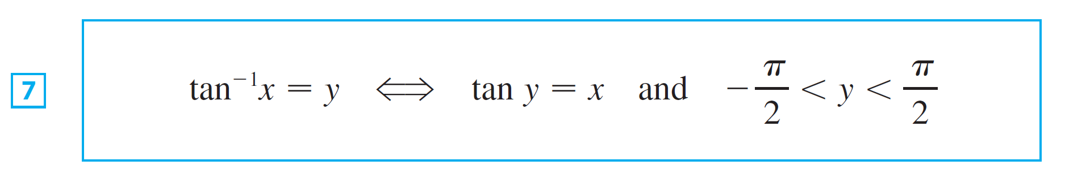
Inverse Trigonometric Functions
It is denoted by tan^{–1} or arctan.

Slide 25
Example 3
Simplify the expression cos(tan⁻¹x).

Slide 26
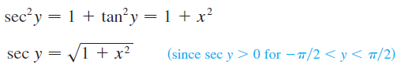

Example 3 – Solution 1
Let y = tan⁻¹x. Then tan y = x and -π /2 < y < π /2.
We want to find cos y, since tan y is known, it’s easier to find sec y first:
Thus

Slide 27

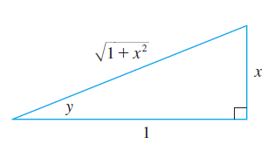
Example 3 – Solution 2
Instead of using trigonometric identities as in Solution 1, it is perhaps easier to use a diagram.
If y = tan⁻¹x , then tan y = x, and we can read from Figure 9 (which illustrates the case y . 0) that
Figure 9

Slide 28

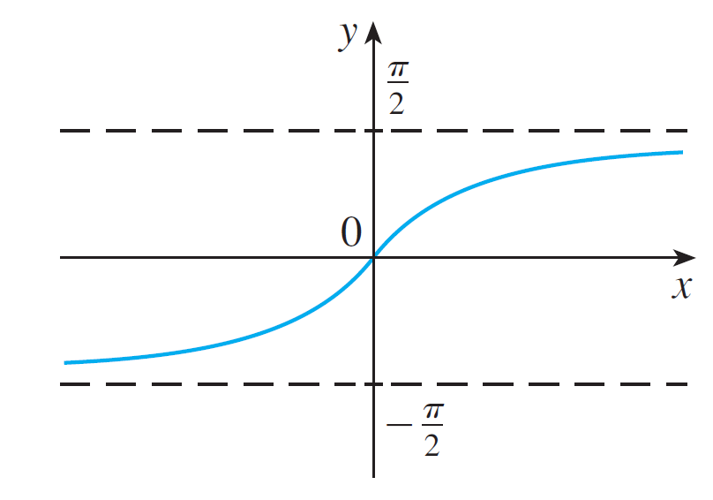

Inverse Trigonometric Functions
The inverse tangent function, tan^{–1} = arctan, has domain and its range is (–π /2, π /2). Its graph is shown in Figure 10.
Figure 10

Slide 29
Inverse Trigonometric Functions
We know that
and so the lines x = ± π /2 are vertical asymptotes of the graph of tan.
Since the graph of tan^{–1} is obtained by reflecting the graph of the restricted tangent function about the line y = x, it follows that the lines y = π /2 and y = –π /2 are horizontal asymptotes of the graph of tan^{–1}.

Slide 30
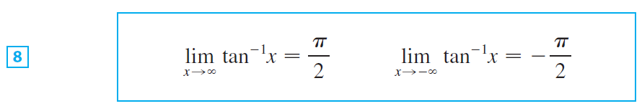
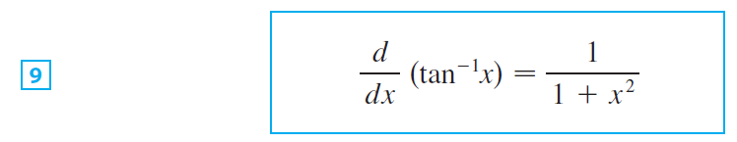
Inverse Trigonometric Functions
This fact is expressed by the following limits:
Since tan is differentiable, tan^{–1} is also differentiable.

Slide 31
Example 4
Evaluate
SOLUTION
Since the first equation in Equations 8 gives:

Slide 32


Inverse Trigonometric Functions
To find its derivative, let y = tan⁻¹x. Then tan y = x. Differentiating this last equation implicitly with respect to x, we have
and so

Slide 33
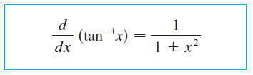
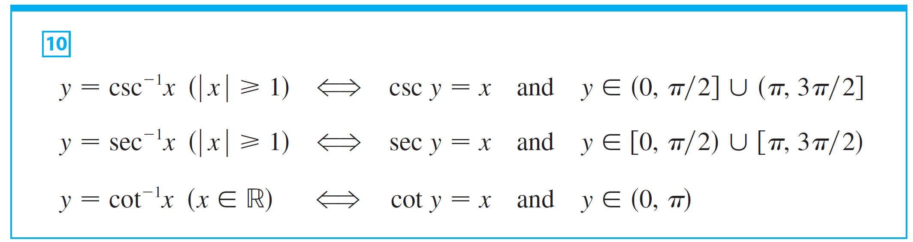
Inverse Trigonometric Functions
The remaining inverse trigonometric functions are summarized here.

Slide 34
Inverse Trigonometric Functions
The choice of intervals for y in the definitions of csc^{–1} and sec^{–1} is not universally agreed upon.
For instance, some authors use in the definition of sec^{–1}.

Slide 35
Inverse Trigonometric Functions
You can see from the graph of the secant function in Figure 11 that both this choice and the one in Equations 10 will work.
The reason for the choice in (10) is that the differentiation formulas are simpler (see Exercise 41).

Slide 36
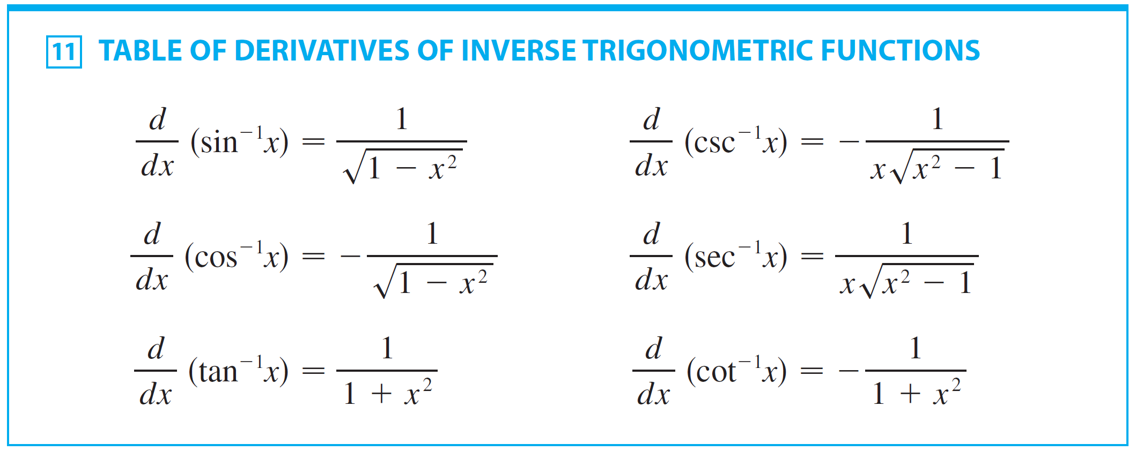
Inverse Trigonometric Functions
We collect in Table 11 the differentiation formulas for all of the inverse trigonometric functions.

Slide 37
Inverse Trigonometric Functions
Each of these formulas can be combined with the Chain Rule. For instance, if u is a differentiable function of x, then

Slide 38
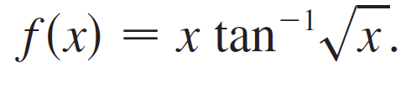
Example 5
Differentiate

Slide 39
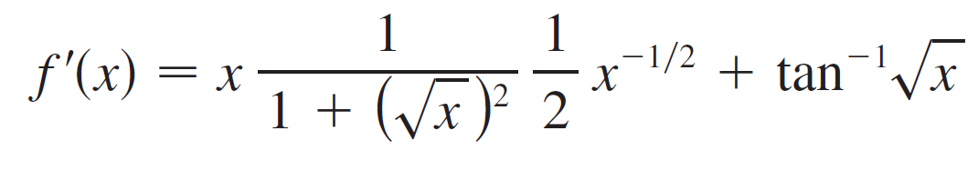
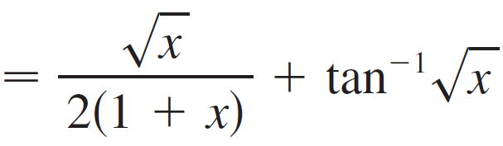
Example 5 – Solution
SOLUTION:

Slide 40
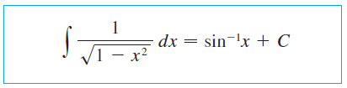
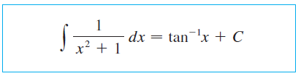

Inverse Trigonometric Functions
Each of the formulas in Table 11 gives rise to an integration formula. The two most useful of these are the following:

Slide 41

Example 6
Find $\int_{0}^{1/4}{\frac{1}{\sqrt{1−4x^{2}}}}dx$

Slide 42

Example 6 – Solution
$$\int_{0}^{1/4}{\frac{1}{\sqrt{1−4x^{2}}}}dx=\frac{1}{2}\int_{0}^{1/2}{\frac{du}{\sqrt{1−u^{2}}}}={\left.\frac{1}{2}\sin^{−1}{u}\right]}_{0}^{1/2} \\ =\frac{1}{2}\left[\sin^{−1}\left(\frac{1}{2}\right)−\sin^{−1}{0}\right] \\ =\frac{1}{2}∙\frac{π}{6} \\ =\frac{π}{12}$$

Slide 43

Example 7
Evaluate

Slide 44
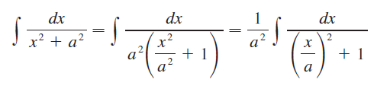

Example 7 – Solution
To make the given integral more like Equation 13 we write
This suggests that we substitute u = x / a. Then
du = dx /a , dx = a du, and

Slide 45
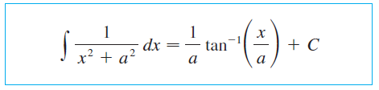
Example 7 – Solution
cont’d
Thus we have the formula

